Slide 1
NEXT - JS
ASSIGNMENT BY
NAILA ADNAN

Slide 2
INTRODUCTION TO NEXT – JS:-
. Next.js is a React-based framework that simplifies the process of building production-ready web applications with features such as server-side rendering, static site generation, API routes, and automatic code splitting. It's built on top of React, which means you can build dynamic, interactive UIs, but Next.js adds several features to enhance the development process and performance.

Slide 3
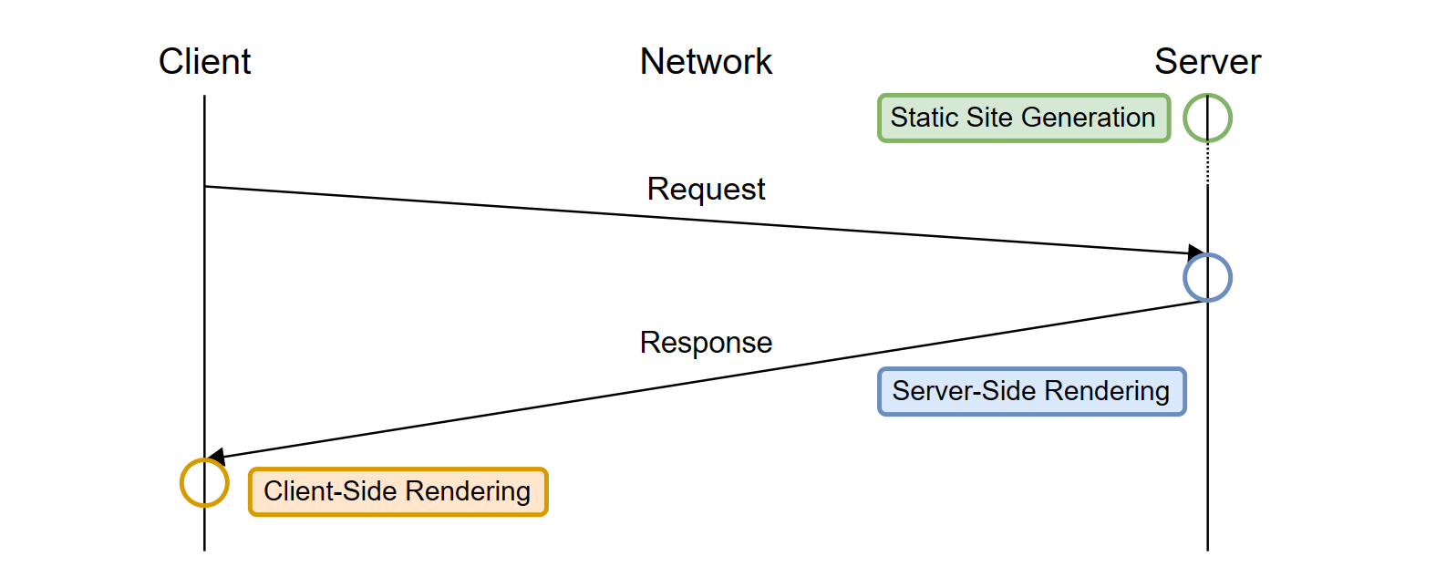
WHAT IS RENDERING?
Rendering in Next.js is a robust feature that gives developers the flexibility to control how content is served to users, enhancing both performance and user experience. With options like Static Site Generation (SSG), Server-Side Rendering (SSR), Client-Side Rendering (CSR), and Incremental Static Regeneration (ISR), Next.js offers customization in content delivery to meet different requirements. SSG generates pages during the build process for quick loading, while SSR creates HTML on-demand with each request, ideal for dynamic content.

Slide 4
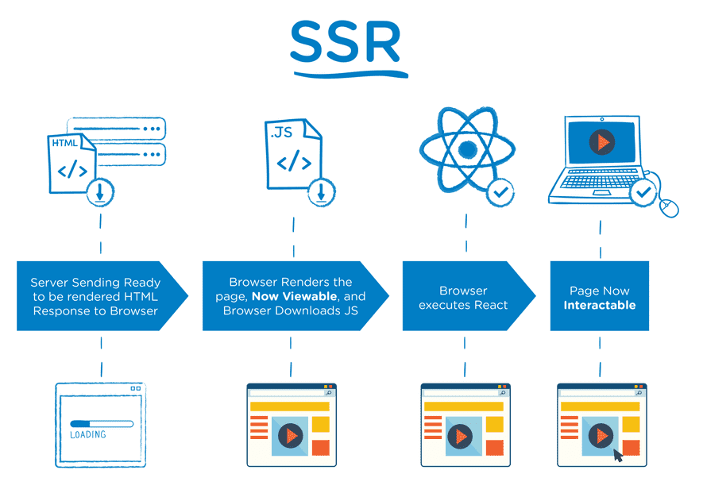
Server-Side Rendering (SSR) in Next.js produces HTML for every request on the server, guaranteeing that users access the latest content. This approach is perfect for pages that need real-time data, such as user profiles or dashboards. With SSR, data retrieval happens through the getServerSideProps function, enabling developers to inject dynamic data directly into the page component. As a result, SSR improves user experiences by providing personalized content in a fast and efficient manner.

Slide 5
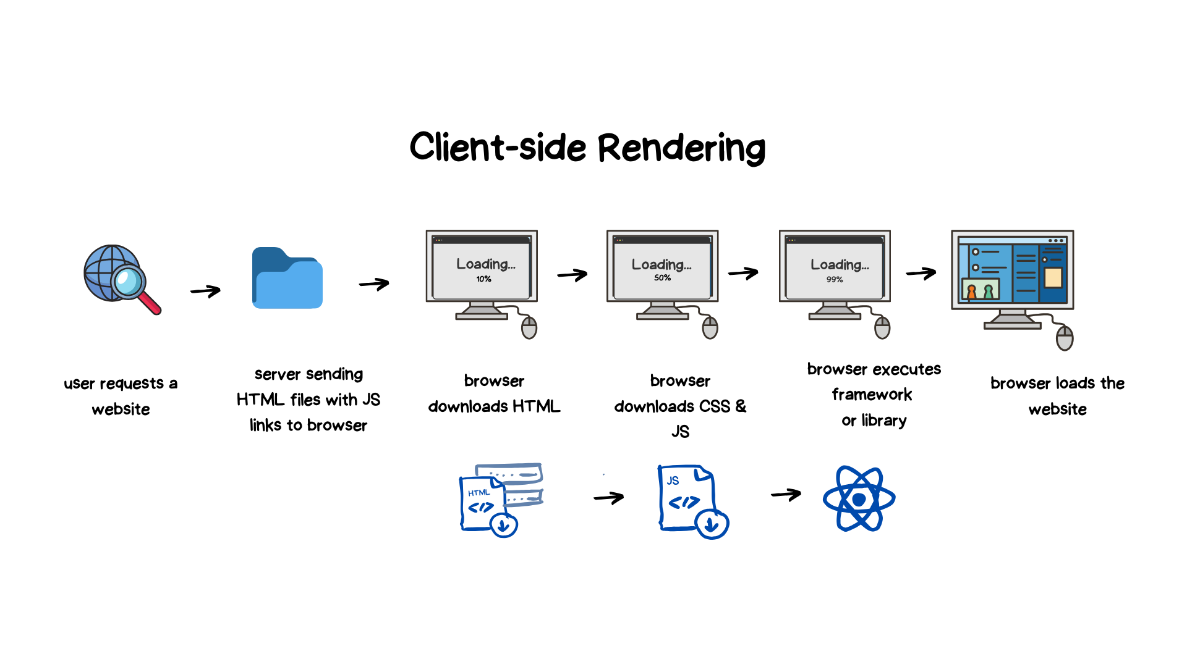
Client-Side Rendering (CSR) in Next.js loads both HTML and data mostly within the browser via JavaScript, enabling dynamic and interactive experiences for users. In CSR, the initial HTML page is lightweight, and additional content is loaded asynchronously once the page is ready. This technique is well-suited for apps with rapidly changing data or high interactivity, like dashboards or single-page applications. However, CSR might result in slower initial load times and may not be as SEO-friendly as server-side rendering methods.

Slide 6
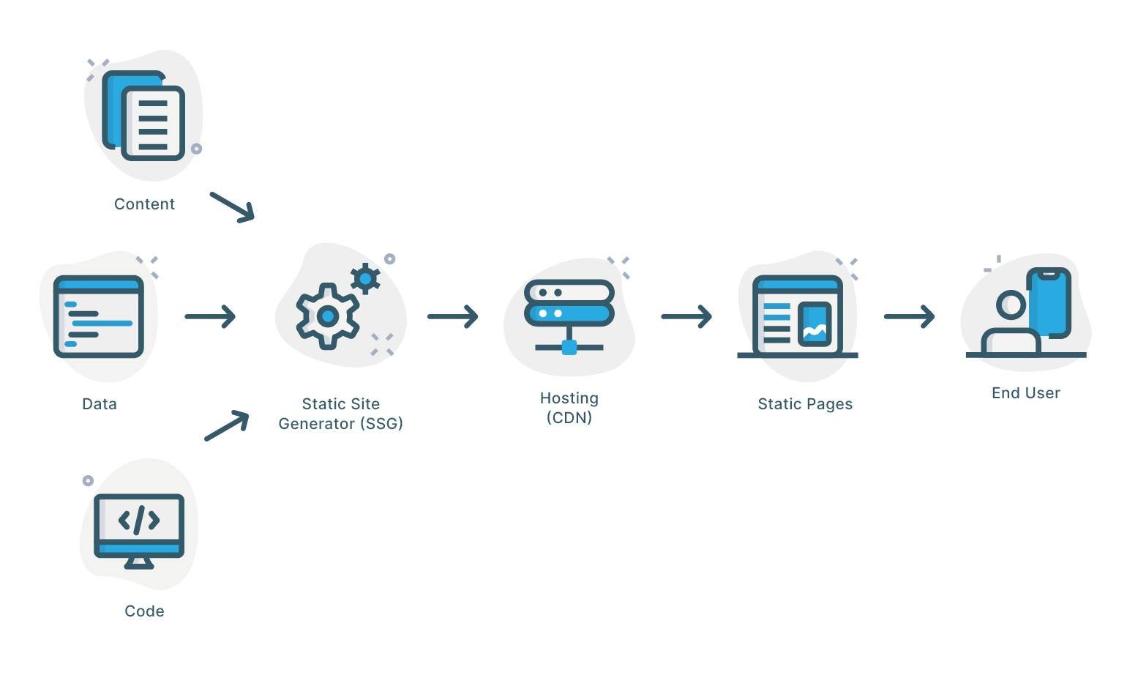
Static Site Generation (SSG)
Static Site Generation (SSG) in Next.js is an effective method for creating fast, high-performance websites by generating static HTML during the build process. This approach prepares content beforehand, enabling quick delivery to users without the need for server-side processing on every request. By using the getStaticProps function, developers can retrieve essential data in advance, ensuring the pages are both optimized for speed and search engine-friendly. SSG is especially useful for websites with content that doesn’t change frequently.

Slide 7
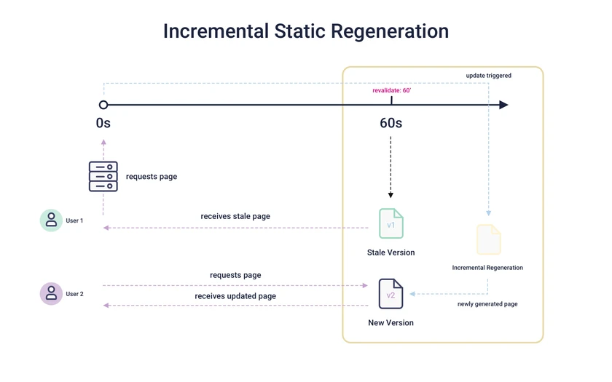
Incremental Static Regeneration (ISR) in Next.js lets developers refresh static content after the site has been deployed, combining static generation with live data updates. By using the revalidate parameter in the getStaticProps function, specific pages can be re-generated at predetermined intervals, ensuring that content stays current without needing to rebuild the entire site. This method is perfect for pages that require regular updates, such as news articles or product catalogs, while still maintaining the performance benefits of static pages.

